Slide 1
实验四
Wireshark HTTP
3 学时

Slide 2
实验目的
掌握Wireshark抓包工具分析HTTP方法。

Slide 3
实验内容概览
The Basic HTTP GET/response interaction
The HTTP CONDITIONAL GET/response interaction
Retrieving Long Documents
HTML Documents with Embedded Objects
HTTP Authentication

Slide 4
The Basic HTTP GET/response interaction
Let’s begin our exploration of HTTP by downloading a very simple HTML file - one that is very short, and contains no embedded objects. Do the following:
Start up your web browser.
Start up the Wireshark packet sniffer. Enter “http” (just the letters, not the quotation marks) in the display-filter-specification window
Wait a bit more than one minute (we’ll see why shortly), and then begin Wireshark packet capture.
Enter the following to your browser
http://gaia.cs.umass.edu/wireshark-labs/HTTP-wireshark-file1.html
Your browser should display the very simple, one-line HTML file.
Stop Wireshark packet capture.

Slide 5
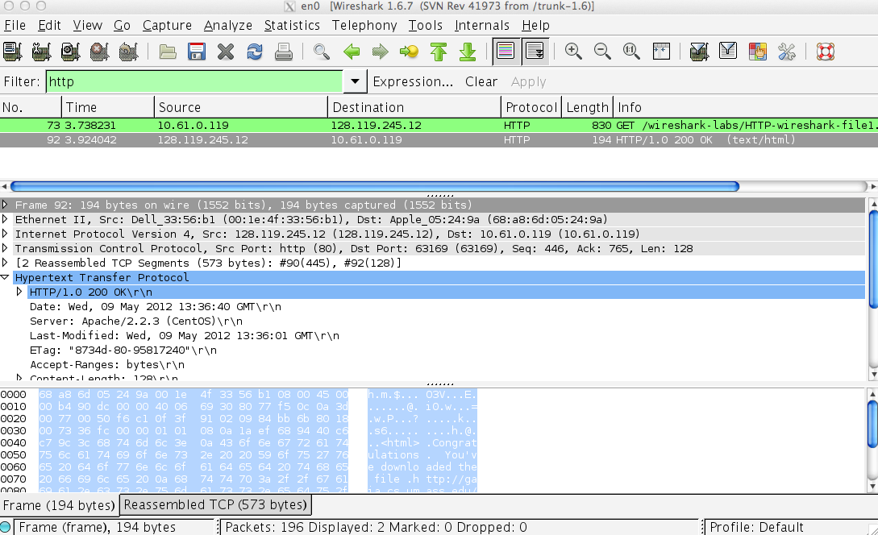
The Basic HTTP GET/response interaction
Figure 1: Wireshark Display after http://gaia.cs.umass.edu/wireshark-labs/ HTTP-wireshark-file1.html has been retrieved by your browser

Slide 6
The Basic HTTP GET/response interaction
By looking at the information in the HTTP GET and response messages, answer the following questions. When answering the following questions, you should print out the GET and response messages (see the introductory Wireshark lab for an explanation of how to do this) and indicate where in the message you’ve found the information that answers the following questions. When you hand in your assignment, annotate the output so that it’s clear where in the output you’re getting the information for your answer (e.g., for our classes, we ask that students markup paper copies with a pen, or annotate electronic copies with text in a colored font).

Slide 7
The Basic HTTP GET/response interaction
Is your browser running HTTP version 1.0 or 1.1? What version of HTTP is the server running?
What languages (if any) does your browser indicate that it can accept to the server?
What is the IP address of your computer? Of the gaia.cs.umass.edu server?
What is the status code returned from the server to your browser?
When was the HTML file that you are retrieving last modified at the server?
How many bytes of content are being returned to your browser?
By inspecting the raw data in the packet content window, do you see any headers within the data that are not displayed in the packet-listing window? If so, name one.

Slide 8
The Basic HTTP GET/response interaction
Is your browser running HTTP version 1.0 or 1.1? What version of HTTP is the server running?
What languages (if any) does your browser indicate that it can accept to the server?
What is the IP address of your computer? Of the gaia.cs.umass.edu server?
What is the status code returned from the server to your browser?
When was the HTML file that you are retrieving last modified at the server?
How many bytes of content are being returned to your browser?
By inspecting the raw data in the packet content window, do you see any headers within the data that are not displayed in the packet-listing window? If so, name one.
Notes:
In your answer to question 5 above, you might have been surprised to find that the document you just retrieved was last modified within a minute before you downloaded the document. That’s because (for this particular file), the gaia.cs.umass.edu server is setting the file’s last-modified time to be the current time, and is doing so once per minute.

Slide 9
The HTTP CONDITIONAL GET/response interaction
Recall from Section 2.2.5 of the text, that most web browsers perform object caching and thus perform a conditional GET when retrieving an HTTP object. Before performing the steps below, make sure your browser’s cache is empty. (for Internet Explorer, select Tools->Internet Options->Delete File; these actions will remove cached files from your browser’s cache.)

Slide 10
The HTTP CONDITIONAL GET/response interaction
Start up your web browser, and make sure your browser’s cache is cleared, as discussed above.
Start up the Wireshark packet sniffer
Enter the following URL into your browser
http://gaia.cs.umass.edu/wireshark-labs/HTTP-wireshark-file2.html
Your browser should display a very simple five-line HTML file.
Quickly enter the same URL into your browser again (or simply select the refresh button on your browser)
Stop Wireshark packet capture, and enter “http” in the display-filter-specification window, so that only captured HTTP messages will be displayed later in the packet-listing window.

Slide 11
The HTTP CONDITIONAL GET/response interaction
Answer the following questions:
8. Inspect the contents of the first HTTP GET request from your browser to the server. Do you see an “IF-MODIFIED-SINCE” line in the HTTP GET?
9. Inspect the contents of the server response. Did the server explicitly return the contents of the file? How can you tell?
10. Now inspect the contents of the second HTTP GET request from your browser to the server. Do you see an “IF-MODIFIED-SINCE:” line in the HTTP GET? If so, what information follows the “IF-MODIFIED-SINCE:” header?
11. What is the HTTP status code and phrase returned from the server in response to this second HTTP GET? Did the server explicitly return the contents of the file? Explain.

Slide 12
Retrieving Long Documents
In our examples thus far, the documents retrieved have been simple and short HTML files. Let’s next see what happens when we download a long HTML file. Do the following:
Start up your web browser, and make sure your browser’s cache is cleared, as discussed above.
Start up the Wireshark packet sniffer
Enter the following URL into your browser
http://gaia.cs.umass.edu/wireshark-labs/HTTP-wireshark-file3.html
Your browser should display the rather lengthy US Bill of Rights.
Stop Wireshark packet capture, and enter “http” in the display-filter-specification window, so that only captured HTTP messages will be displayed.

Slide 13
Retrieving Long Documents
Answer the following questions:
12. How many HTTP GET request messages did your browser send? Which packet number in the trace contains the GET message for the Bill or Rights?
13. Which packet number in the trace contains the status code and phrase associated with the response to the HTTP GET request?
14. What is the status code and phrase in the response?
15. How many data-containing TCP segments were needed to carry the single HTTP response and the text of the Bill of Rights?

Slide 14
HTML Documents with Embedded Objects
We can look at what happens when your browser downloads a file with embedded objects, i.e., a file that includes other objects (in the example below, image files) that are stored on another server(s).
Do the following:
Start up your web browser, and make sure your browser’s cache is cleared, as discussed above.
Start up the Wireshark packet sniffer

Slide 15
HTML Documents with Embedded Objects
Enter the following URL into your browser
http://gaia.cs.umass.edu/wireshark-labs/HTTP-wireshark-file4.html
Your browser should display a short HTML file with two images. These two images are referenced in the base HTML file. That is, the images themselves are not contained in the HTML; instead the URLs for the images are contained in the downloaded HTML file. As discussed in the textbook, your browser will have to retrieve these logos from the indicated web sites. Our publisher’s logo is retrieved from the gaia.cs.umass.edu web site. The image of the cover for our 5th edition (one of our favorite covers) is stored at the caite.cs.umass.edu server. (These are two different web servers inside cs.umass.edu).
Stop Wireshark packet capture, and enter “http” in the display-filter-specification window, so that only captured HTTP messages will be displayed.

Slide 16
HTML Documents with Embedded Objects
Answer the following questions:
16. How many HTTP GET request messages did your browser send? To which Internet addresses were these GET requests sent?
17. Can you tell whether your browser downloaded the two images serially, or whether they were downloaded from the two web sites in parallel? Explain.

Slide 17
HTTP Authentication
Finally, let’s try visiting a web site that is password-protected and examine the sequence of HTTP message exchanged for such a site. The URL
http://gaia.cs.umass.edu/wireshark-labs/protected_pages/HTTP-wireshark-file5.html is password protected. The username is “wireshark-students” (without the quotes), and the password is “network” (again, without the quotes). So let’s access this “secure” password-protected site.

Slide 18
HTTP Authentication
Do the following:
Make sure your browser’s cache is cleared, as discussed above, and close down your browser. Then, start up your browser
Start up the Wireshark packet sniffer
Enter the following URL into your browser
http://gaia.cs.umass.edu/wireshark-labs/protected_pages/HTTP-wireshark-file5.html
Type the requested user name and password into the pop up box.
Stop Wireshark packet capture, and enter “http” in the display-filter-specification window, so that only captured HTTP messages will be displayed later in the packet-listing window.
Now let’s examine the Wireshark output. You might want to first read up on HTTP authentication by reviewing the easy-to-read material on “HTTP Access Authentication Framework” at http://frontier.userland.com/stories/storyReader$2159

Slide 19
HTTP Authentication
Answer the following questions:
18. What is the server’s response (status code and phrase) in response to the initial HTTP GET message from your browser?
19. When your browser’s sends the HTTP GET message for the second time, what new field is included in the HTTP GET message?

Slide 20
HTTP Authentication
The username (wireshark-students) and password (network) that you entered are encoded in the string of characters (d2lyZXNoYXJrLXN0dWRlbnRzOm5ldHdvcms=) following the “Authorization: Basic” header in the client’s HTTP GET message. While it may appear that your username and password are encrypted, they are simply encoded in a format known as Base64 format. The username and password are not encrypted! To see this, go to http://www.motobit.com/util/base64-decoder-encoder.asp and enter the base64-encoded string d2lyZXNoYXJrLXN0dWRlbnRz and decode. Voila! You have translated from Base64 encoding to ASCII encoding, and thus should see your username! To view the password, enter the remainder of the string Om5ldHdvcms= and press decode.

Slide 21
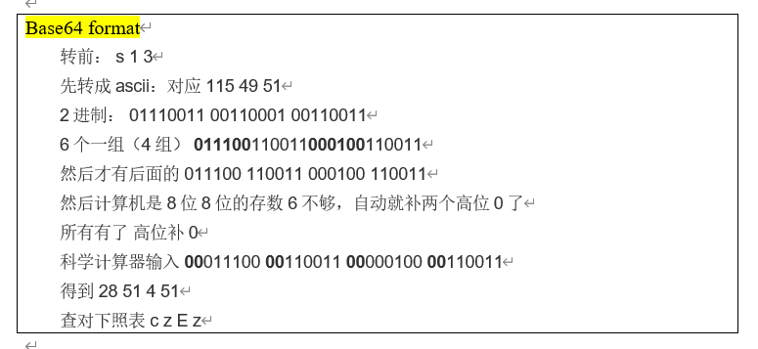
HTTP Authentication

